Slide 1
Classes and objects

Slide 2
Object
An entity that has state and behavior is known as an object e.g., chair, bike, marker, pen, table, car, etc. It can be physical or logical (tangible and intangible). The example of an intangible object is the banking system.
An object has three characteristics:
State: represents the data (value) of an object.
Behavior: represents the behavior (functionality) of an object such as deposit, withdraw, etc.
Identity: An object identity is typically implemented via a unique ID. The value of the ID is not visible to the external user. However, it is used internally by the JVM to identify each object uniquely.
An object is an instance of a class. A class is a template or blueprint from which objects are created. So, an object is the instance(result) of a class.
Object Definitions:
An object is a real-world entity.
An object is a runtime entity.
The object is an entity which has state and behavior.
The object is an instance of a class.

Slide 3
Class
A class is a group of objects which have common properties. It is a template or blueprint from which objects are created. It is a logical entity. It can't be physical.
A class in Java can contain:
Fields
Methods
Constructors
Blocks
Nested class and interface
Syntax to declare a class:
class <class_name>{
field;
method;
}

Slide 4
Instance variable in Java
A variable which is created inside the class but outside the method is known as an instance variable. Instance variable doesn't get memory at compile time. It gets memory at runtime when an object or instance is created. That is why it is known as an instance variable.

Slide 5
Method in Java
In Java, a method is like a function which is used to expose the behavior of an object.
Advantage of Method
Code Reusability
Code Optimization

Slide 6
new keyword in Java
The new keyword is used to allocate memory at runtime. All objects get memory in Heap memory area.

Slide 7
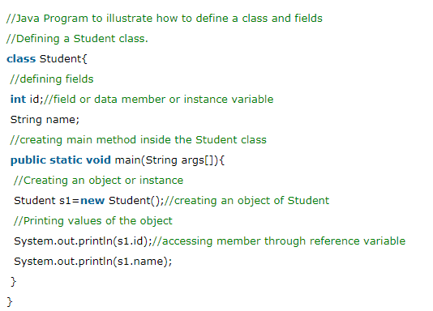
main within the class

Slide 8
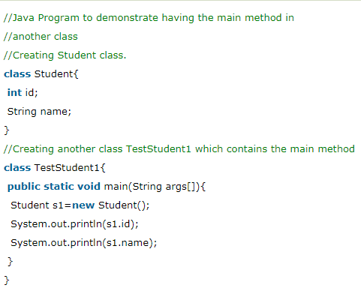
main outside the class
We can have multiple classes in different Java files or single Java file. If you define multiple classes in a single Java source file, it is a good idea to save the file name with the class name which has main() method.

Slide 9
3 Ways to initialize object
There are 3 ways to initialize object in Java.
By reference variable
By method
By constructor
1. Initialization through reference
Initializing an object means storing data into the object. Let's see a simple example where we are going to initialize the object through a reference variable.

Slide 10
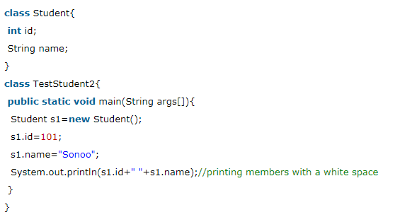

Slide 11
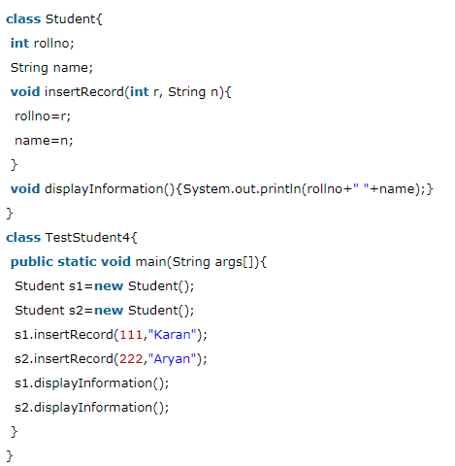
2. Initialization through method
In this example, we are creating the two objects of Student class and initializing the value to these objects by invoking the insertRecord method. Here, we are displaying the state (data) of the objects by invoking the displayInformation() method.

Slide 12
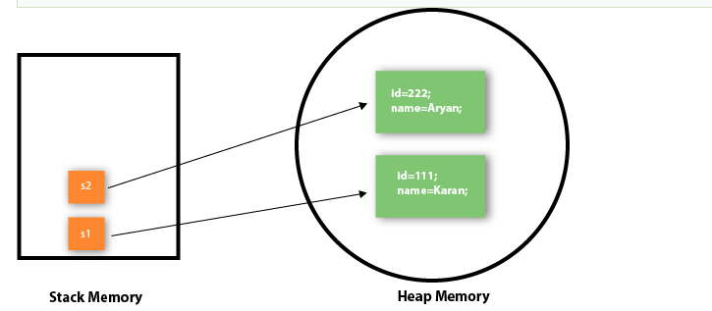
As you can see in the below figure, object gets the memory in heap memory area. The reference variable refers to the object allocated in the heap memory area. Here, s1 and s2 both are reference variables that refer to the objects allocated in memory.

Slide 13
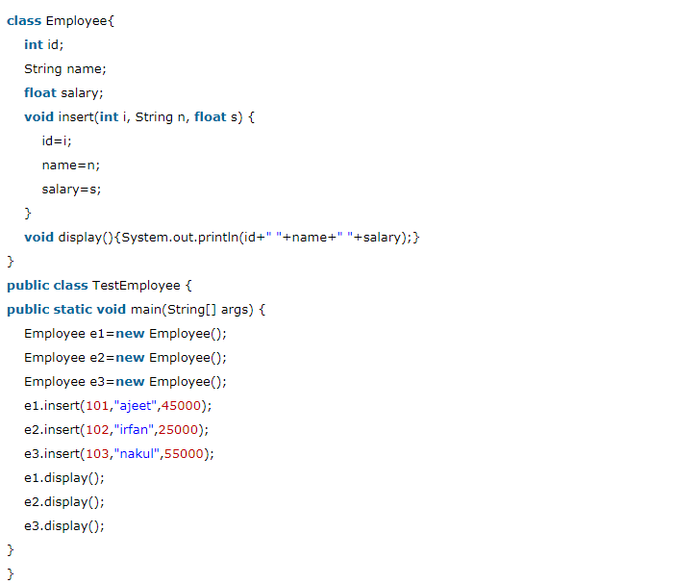
3. Initialization through a constructor
Object and Class Example: Employee

Slide 14
What are the different ways to create an object in Java?
There are many ways to create an object in java. They are:
By new keyword
By newInstance() method
By clone() method
By deserialization
By factory method etc.

Slide 15
Anonymous object
Anonymous simply means nameless. An object which has no reference is known as an anonymous object. It can be used at the time of object creation only.
If you have to use an object only once, an anonymous object is a good approach. For example:
new Calculation();//anonymous object
Calling method through a reference:
Calculation c =new Calculation();
c.fact(5);
Calling method through an anonymous object
new Calculation().fact(5);

Slide 16
Creating multiple objects by one type only
We can create multiple objects by one type only as we do in case of primitives.
Initialization of primitive variables:
int a=10, b=20;
Initialization of refernce variables:
Rectangle r1=new Rectangle(), r2=new Rectangle();//creating two objects

